Slide 1
COMMON STACKS

Slide 2


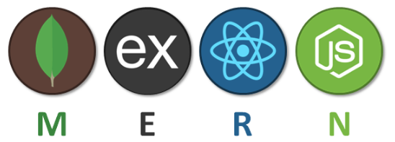
COMMON JAVASCRIPT STACKS

Slide 3
OTHER COMMON STACKS
Python Stack: Django, python, and MySQL as database
Ruby Stack: Ruby, PHP, and MySQL
Linux Stack: Linux, Apache, MySQL, and PHP
Microsoft stack: Blazor, ASP.NET, C#, SQL Server

